Slide 1

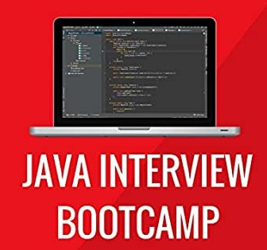
JAVA INTERVIEW module
Lecture 3

Slide 2

Today’s Agenda
JDK,JRE,JVM and JITC
Popular Interview Questions

Slide 3
JDK V/s JRE V/s JVM V/s JIT
Understanding the difference between JDK,JRE ,JVM and JITC is very very important in Java for interviews
JDK: Java Development kit
JRE: Java Runtime Environment
JVM: Java Virtual Machine
JITC: Just In Time Compiler

Slide 4
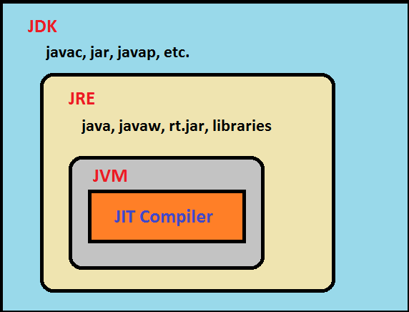
JDK V/s JRE V/s JVM V/s JIT

Slide 5
What Is JVM ?
JVM is the heart of Java programming language, which is responsible for converting Byte code to the machine specific code.
JVM provides core functionality like memory management, garbage collection, security etc.
It is designed for each platform(OS+CPU) supported by Java and this means that every platform will have a different version of JVM

Slide 6
What Is Inside JVM ?
Apart from garbage collector and other important tools , the JVM contains 2 translators:
Interpreter
JITC (Just In Time Compiler)

Slide 7
How JITC Works ?
The JIT compiler is enabled by default, and is activated whenever a Java method is called.
It then looks for HOT SPOTS.

Slide 8
How JITC Works ?
As soon as the JITC finds a HOT SPOT , it compiles the bytecode of that method into native machine code, compiling it "just in time" to run.
This means that JITC performs compilation during execution as compared to javac which compiles our code before execution

Slide 9
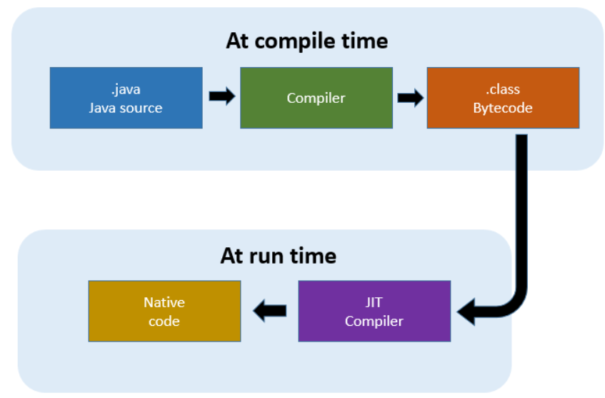
The JIT Compiler

Slide 10
Interpreter V/s JITC
Originally Java only had an interpreter which simply converted bytecode to machine language and sends it for execution to the computer.
But , like any other interpreter , the Java Interpreter also converts one line of bytecode to machine language and sends it for execution to the computer.
Then it repeats the same process for line 2

Slide 11
Is There A Problem In This Approach ?
Yes
If an instruction needs to be executed 100 times (for example inside a loop) then the interpreter needs to convert it 100 times.
For example
a=10,i=1;
loop(i<=100)
{
print a;
i++;
}
a=10;
print a;
In the second example the interpreter will have to convert the
statement print a; 100 times since it is running inside a loop

Slide 12
What Is The Solution ?
To solve this problem the developers at SUN came up with a new idea.
They thought if a statement has to be executed multiple times then why not save the converted code in computer’s memory and then next time just execute it without converting it.
That is in the previous code , the statement print a; which is inside the loop would be converted only once and saved in computer’s memory and remaining 99 times it is just executed !.
This is called JITC(Just In Time Compiler) and the statements which have to be executed multiple times are called HotSpots and thus Java’s JVM is also called HotSpot JVM

Slide 13
Popular Interview Question
Are the Java compiler and JITC same?
Answer:
No , not at all.
The java compiler converts source code to bytecode and is not a part of JVM , rather it comes with JDK.
The JITC lives inside the JVM and converts bytecode to machine understandable form

Slide 14
What Is JRE ?
JRE is an acronym for Java Runtime Environment.
It provides a platform to execute Java programs.
It contains a JVM along with java classes/packages ,set of runtime libraries and java application launcher called java.exe
To execute any Java application, we need JRE installed in the machine. It’s the minimum requirement to execute a Java application on any machine.

Slide 15
What Is JDK ?
JDK stands for Java Development Kit and is a bundle of software that we can use to develop Java based applications.
It includes the JRE, set of library classes, Java compiler , jar and additional files needed to write a Java application.

Slide 16
Popular Interview Question
Can I compile a Java application if I have a JRE ?
Yes
No
Answer:
No , JRE can only be used to run a Java application . It doesn’t contain the javac tool which is used for compilation

Slide 17
Popular Interview Question
Which component is used to compile, debug and execute java program?
A. JVM
B. JDK
C. JIT
D. JRE
Correct Answer:
B

Slide 18
Popular Interview Question
Which component is used to optimize our Java code ?
A. JVM
B. JDK
C. JIT
D. JRE
Correct Answer:
C

Slide 19
Popular Interview Question
Which component is used to convert bytecode to machine specific code ?
A. JVM
B. JDK
C. JIT
D. JRE
Correct Answer:
A

Slide 20
Popular Interview Question
Which component saves the converted machine specific code in computer’s memory if required?
A. JVM
B. JDK
C. JIT
D. JRE
Correct Answer:
C

Slide 21
Popular Interview Question
Which component is used to provide a platform to run a Java program ?
A. JVM
B. JDK
C. JIT
D. JRE
Correct Answer:
D

